Slide 1
Skin Disease Detection App

Slide 2
Submitted by:
KARUNA RANI - 20BCS6700
PANKAJ SINGH KANYAL - 20BCS6668
MANAS MISHRA - 20BCS6695
JATIN SHARMA - 20BCS6697

Slide 3
Table Of Content
INTRODUCTION
PROBLEM INTORDUCTION
METHODOLOGY USED
DISEASES DETECTED IN OUR SYSTEM

Slide 4
INTRODUCTION

Slide 5
Introduction
Skin diseases are really common.
They may be caused by fungal infection, bacteria, allergy or viruses, etc.
Skin diseases must be diagnosed early to reduce their development and spread.

Slide 6
Introduction
Due to lack of medical knowledge most of the people do not know the type and stage of a skin disease.
Sometimes, a dermatologist may also find it difficult to diagnose the skin disease.
The advancement of medical technology has made it possible to diagnose the skin diseases much more quickly and accurately.
But still diagnose is a really expensive procedure .

Slide 7
Therefore, we propose an image processing-based approach to diagnose the skin diseases. This method takes the digital image of disease effect skin area then use image analysis to identify the type of disease.
Our proposed approach is simple, fast and does not require expensive equipment's other than a camera, a computer and an android /ios device.

Slide 8
PROBLEM INTRODUCTION

Slide 9
1. EXPENSIVE TREATMENT :
The advance laser techniques and photonics based medical technology is still limited and hence expensive.
2. LACK OF KNOWLEDGE:
Most of the common people do not know the type, symptoms and stage of a skin disease.

Slide 10
3. BUSY SCHEDULES:
People find it difficult to take a break from their busy life’s and take an appointment for a dermatologist. That’s why many people ignore the skin related problems.
4. SKIN DISEASES ARE COMMON IN INDIA:
These days, skin related problems are very common in India. Some of the reasons are polluted air, non-nutritious food, garbage, climate changes etc.

Slide 11
5. SOMETIMES DIFFICULT FOR DERMATOLOGIST
TO RECTIFY THE CAUSE:
Some of the diseases show symptoms several months later. Some type of diseases changes the texture and color of the skin. That’s why it becomes difficult sometimes for the dermatologist to rectify the actual cause on time.

Slide 12
METHODOLOGY USED

Slide 13
1. PLANNING
A project plan was developed as well as other planning documents was also discussed by the team members . Planning provided us the basis for acquiring the resources needed to achieve a solution . This phase of our project helped us in finding out that what was the actual dilemmas that are needed to be solved .
2. ANALYSIS
This step involved breaking down the system in different pieces to analyze the situation , analyzing project goals , breaking down what needed to be created and an attempt to engage users so that definite requirements could be defined .

Slide 14
3. SEMI-STRUCTURED INTERVIEWS
Semi structured interviews were conducted with a fairly open framework which allowed us to have a focused conversational , two way communication . It was used as both to give and receive information .
4. DIRECT OBSERVATIONS
Direct observation was used as a research methodology of choice in designing the management system for hospital because observations give additional , more accurate information on behavior of people than interviews or questionnaires.

Slide 15
5. USING AVAIABLE INFORMATION
In the development of hospital management system , this research methodology was mainly used in the analysis and design phases of the system development process . This is because it will permit the researcher to analyze changes in trends.

Slide 16

Model creation
The Model created by the author is created by Google Teachable Machine (Web-based GUI). The Training Epochs were taken as 50, with a batch size of 16 and a learning rate of 0.001.

Slide 17
App Development
The application developed is coded in a modular fashion. The primary language used for programming the application is dart using the flutter framework.
The application performance is dependent upon the goodness of the Model. The application does not require internet or cloud connectivity to work.

Slide 18
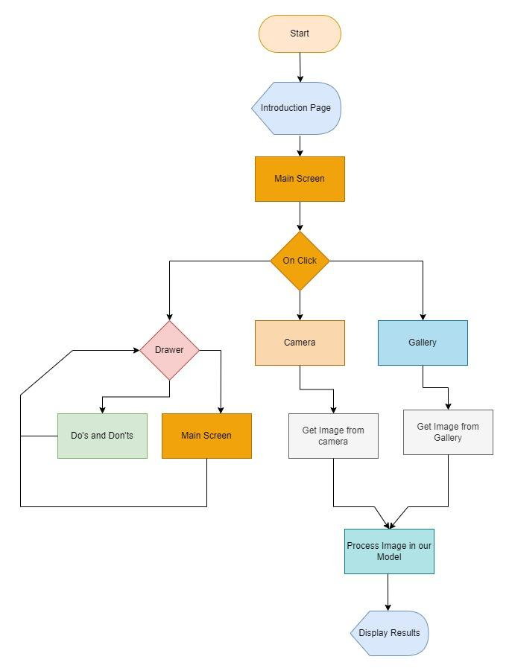

Slide 19
Navigation
In an application developed, Routes are used to navigate through different screens. On using scaffold with drawer widget. The user can easily able to navigate through different pages. In Fig 9. It can be seen that navigation between Main Screen and the Do’s and Don’t screen is possible with the help of the drawer.

Slide 20
Model Loading
In Fig 9. The model is loaded into the memory as soon as the user clicks on the camera or the gallery button.
After collecting the image through the camera or gallery which is shown as the collect images in Fig 8. The image is then fed into the model. The model returns the output in the form of a dynamic <list> data type from which the result and accuracy can be obtained.

Slide 21
Diseases detected in our system
HIVES
BLISTER
ACNE
CHICKENPOX
ECZEMA
MELANOMA
PSORAISES

Slide 22
TECH STACK USED

Slide 23



Flutter Framework
Vs code
Virtual Smartphone Emulator

Slide 24
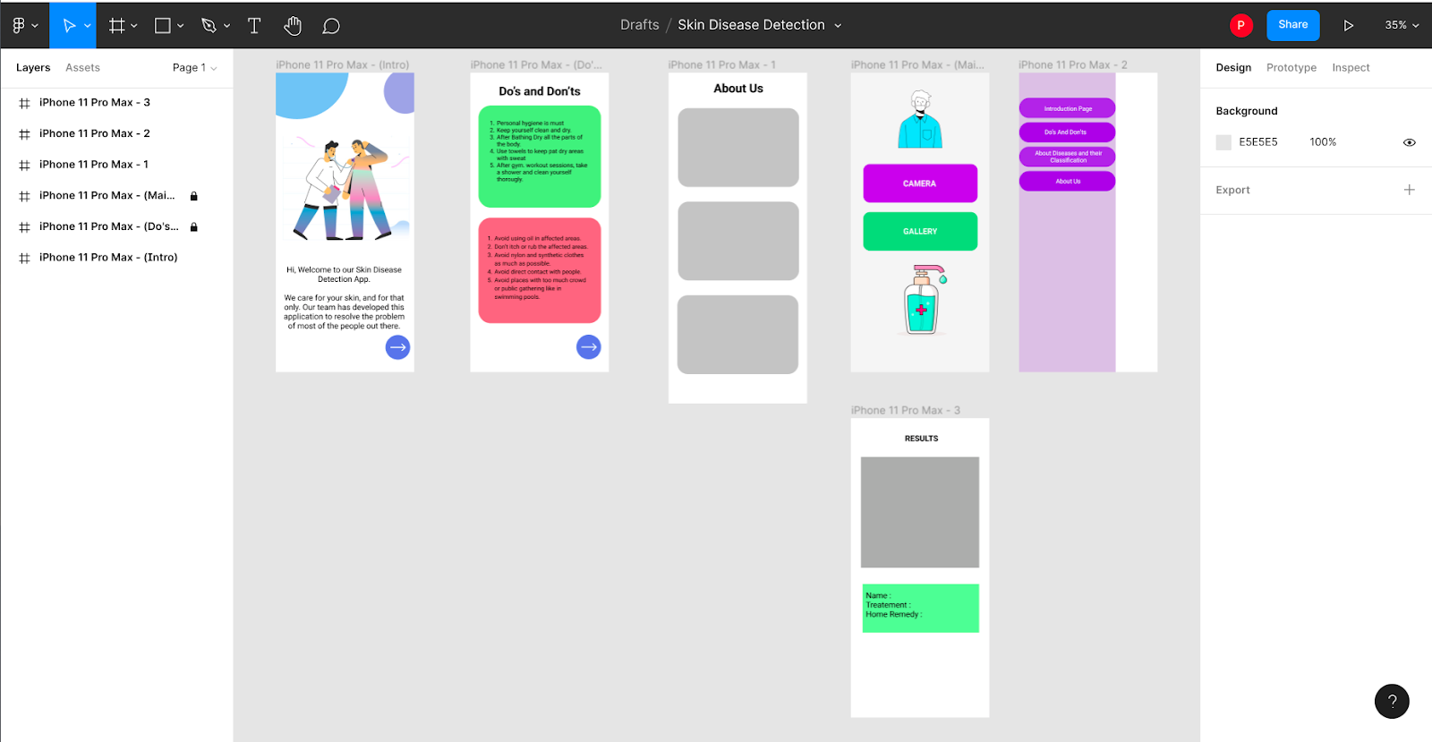
For Designing
Figma

Slide 25
SYSTEM
DESIGN

Slide 26
SYSTEM DESIGN
The purpose of Design phase is to plan a solution for problem specified by the requirements. System design aims to identify the modules that should be in the system, the specification of those modules and how they interact with each other to produce the results. The goal of the design process is to produce a model that can be used later to build that system. The produced model is called design of the system. System design is the process of defining the architecture, components, modules, interfaces and data for a system to satisfy specified requirements. Normally, the design proceeds in two stages:

Slide 27
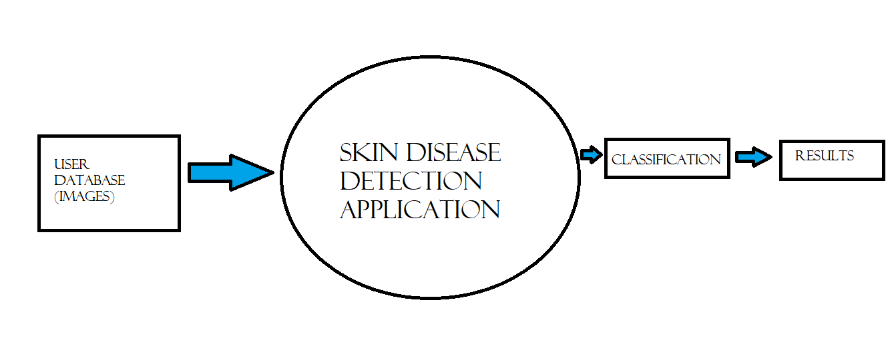
PHYSICAL DESIGEN
LEVEL 0 –

Slide 28
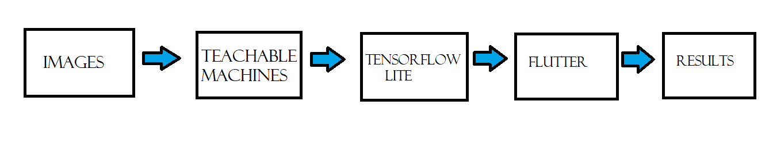
LEVEL 1 -

Slide 29
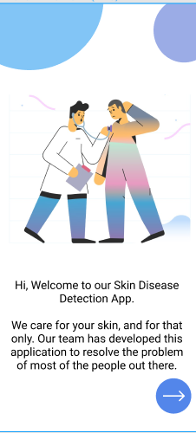
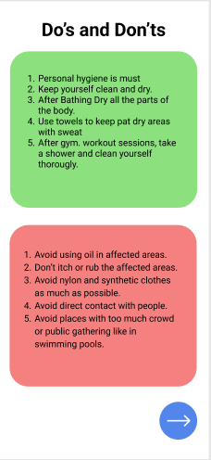
DATA BASE DESIGN (Welcome page module)
Do’s and Don’ts
Page
Home Page

Slide 30
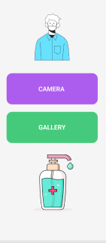
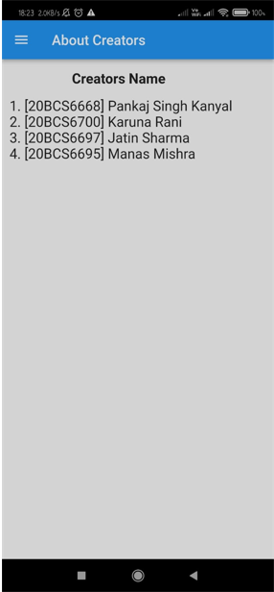
About Us
Upload Page

Slide 31
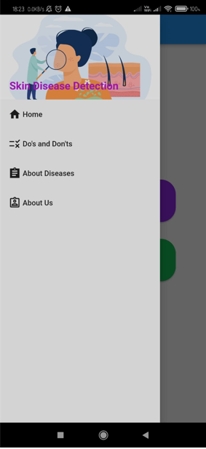
About Us
31
Navigation
Module

Slide 32
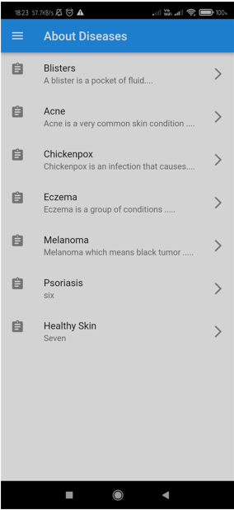
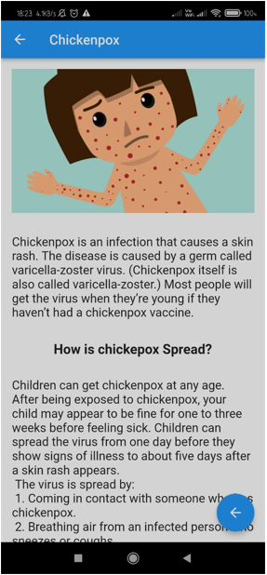
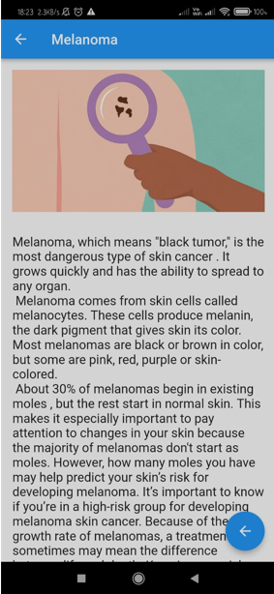
About
Diseases

Slide 33
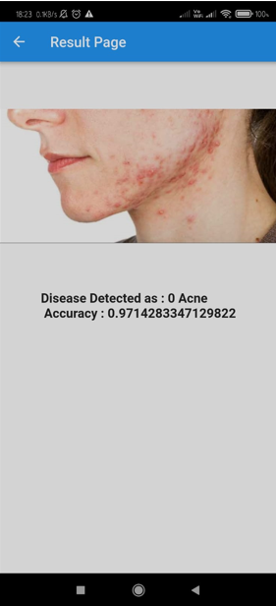
Result Module
The result page detect and tell the skin disease with promising results combining computer vision and machine learning techniques.

Slide 34
CONCLUSION
The proposed system is able to detect the skin disease with promising results combining computer vision and machine learning techniques.
It can be used to help people from all over the world and can be used in doing some productive work.
The tools used are free to use and are available for the user, hence, the system can be deployed free of cost.

Slide 35
The application developed is light-weight and can be used in machines with low system specifications.
It has also a simple user interface for the convenience of the user. The image processing and machine learning algorithms were successfully implemented.

Slide 36
Thank You

